Slide 1
Artificial intelligence
Session – 14
Date – 17th June, 2022

Slide 2
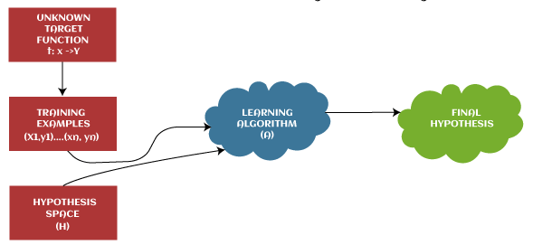
What is Hypothesis?
The hypothesis is defined as the supposition or proposed explanation based on insufficient evidence or assumptions. It is just a guess based on some known facts but has not yet been proven. A good hypothesis is testable, which results in either true or false.
Example: Let's understand the hypothesis with a common example. Some scientist claims that ultraviolet (UV) light can damage the eyes then it may also cause blindness.
In this example, a scientist just claims that UV rays are harmful to the eyes, but we assume they may cause blindness. However, it may or may not be possible. Hence, these types of assumptions are called a hypothesis.
There are some common methods given to find out the possible hypothesis from the Hypothesis space, where hypothesis space is represented by uppercase-h (H) and hypothesis by lowercase-h (h).

Slide 3
Hypothesis space (H)
Hypothesis space is defined as a set of all possible legal hypotheses; hence it is also known as a hypothesis set. It is used by supervised machine learning algorithms to determine the best possible hypothesis to describe the target function or best maps input to output.
It is often constrained by choice of the framing of the problem, the choice of model, and the choice of model configuration.

Slide 4
Hypothesis (h)
It is defined as the approximate function that best describes the target in supervised machine learning algorithms. It is primarily based on data as well as bias and restrictions applied to data.
Hence hypothesis (h) can be concluded as a single hypothesis that maps input to proper output and can be evaluated as well as used to make predictions.
The hypothesis (h) can be formulated in machine learning as follows:
y= mx + b
Where,
Y: Range
m: Slope of the line which divided test data or changes in y divided by change in x.
x: domain
c: intercept (constant)

Slide 5
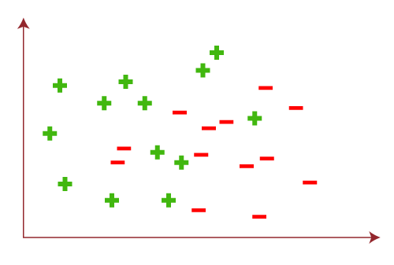
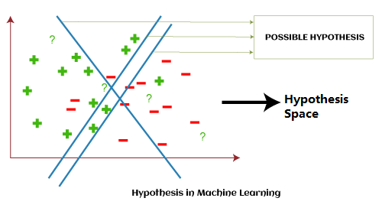
Example
Hypothesis space (H) is the composition of all legal best possible ways to divide the coordinate plane so that it best maps input to proper output.
Further, each individual best possible way is called a hypothesis (h). Hence, the hypothesis and hypothesis space would be like this:

Slide 6
Hypothesis in Statistics
Null Hypothesis: A null hypothesis is a type of statistical hypothesis which tells that there is no statistically significant effect exists in the given set of observations. It is also known as conjecture and is used in quantitative analysis to test theories about markets, investment, and finance to decide whether an idea is true or false.
Alternative Hypothesis: An alternative hypothesis is a direct contradiction of the null hypothesis, which means if one of the two hypotheses is true, then the other must be false. In other words, an alternative hypothesis is a type of statistical hypothesis which tells that there is some significant effect that exists in the given set of observations.

Slide 7
P-value
The p-value in statistics is defined as the evidence against a null hypothesis. In other words, P-value is the probability that a random chance generated the data or something else that is equal or rarer under the null hypothesis condition.
If the p-value is smaller, the evidence will be stronger, and vice-versa which means the null hypothesis can be rejected in testing. It is always represented in a decimal form, such as 0.035.
Whenever a statistical test is carried out on the population and sample to find out P-value, then it always depends upon the critical value. If the p-value is less than the critical value, then it shows the effect is significant, and the null hypothesis can be rejected. Further, if it is higher than the critical value, it shows that there is no significant effect and hence fails to reject the Null Hypothesis.

Slide 8
Prediction Error
In statistics, prediction error refers to the difference between the predicted values made by some model and the actual values.
Prediction error is often used in two settings:
1. Linear regression: Used to predict the value of some continuous response variable.
We typically measure the prediction error of a linear regression model with a metric known as RMSE, which stands for root mean squared error.
It is calculated as:
RMSE = √Σ(ŷ_{i} – y_{i})² / n
1. RMSE = sqrt[sum{square(predited value of ith observation - observed value of the ith observation)}/sample size]
2. Lower RMSE means a given model is able to best "fit" a dataset

Slide 9
How to Interpret Root Mean Square Error
Regression analysis is a technique we can use to understand the relationship between one or more predictor variables and a response variable.
One way to assess how well a regression model fits a dataset is to calculate the root mean square error, which is a metric that tells us the average distance between the predicted values from the model and the actual values in the dataset.
The lower the RMSE, the better a given model is able to “fit” a dataset.

Slide 10
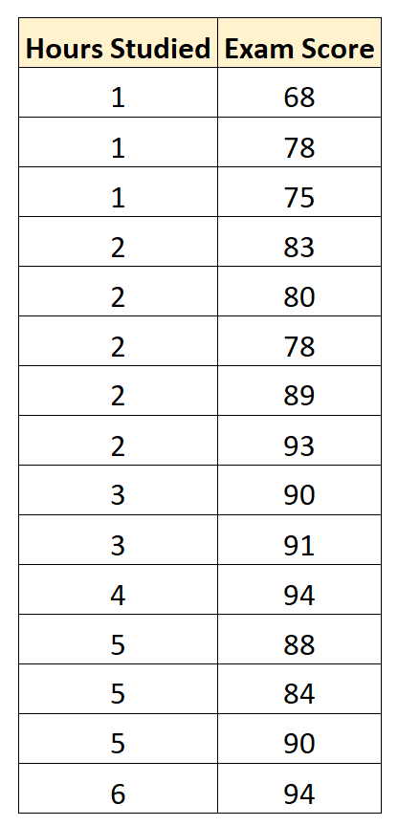
Example: How to Interpret RMSE for a Regression Model
Suppose we would like to build a regression model that uses “hours studied” to predictor “exam score” of students on a particular college entrance exam.
We collect the following data for 15 students:

Slide 11
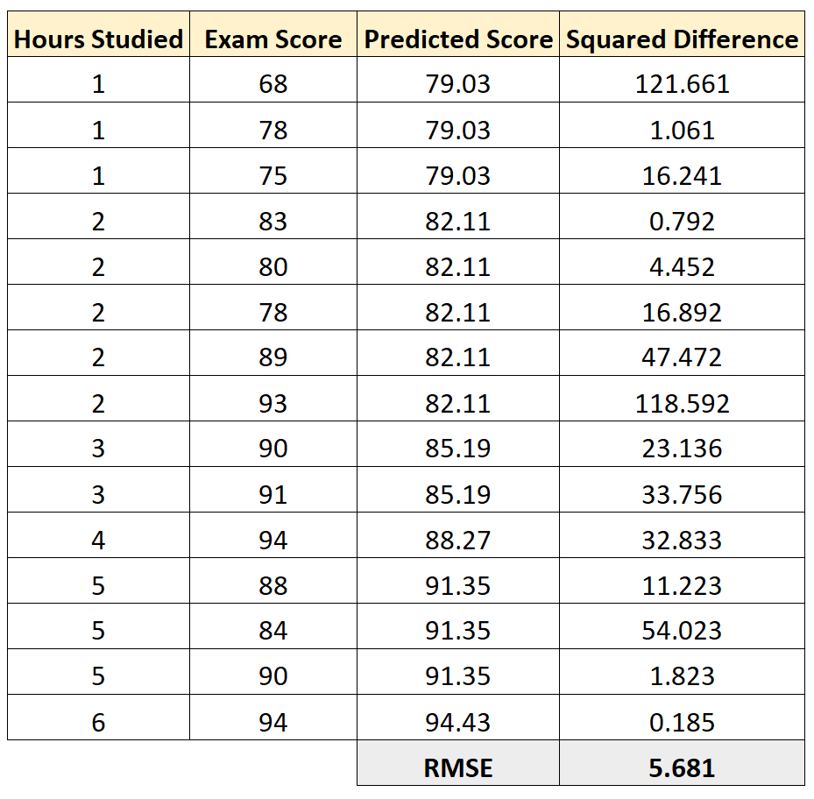
Example: How to Interpret RMSE for a Regression Model
We can then calculate the squared difference between each predicted exam score and the actual exam score. Then we can take the square root of the mean of these differences:
This is a useful value to know because it gives us an idea of the average distance between the observed data values and the predicted data values.

Slide 12
Discrete vs Continuous variables
Discrete variables are countable in a finite amount of time. For example, you can count the change in your pocket. You can count the money in your bank account. You could also count the amount of money in everyone’s bank accounts. It might take you a long time to count that last item, but the point is—it’s still countable.
Continuous Variables would (literally) take forever to count. In fact, you would get to “forever” and never finish counting them. For example, take age. You can’t count “age”. Why not? Because it would literally take forever. For example, you could be: 25 years, 10 months, 2 days, 5 hours, 4 seconds, 4 milliseconds, 8 nanoseconds, 99 picosends…and so on.

Slide 13
Prediction Error
2. Logistic Regression: Used to predict the value of some binary response variable.
One common way to measure the prediction error of a logistic regression model is with a metric known as the total misclassification rate.
It is calculated as:
Total misclassification rate = (# incorrect predictions / # total predictions)
The lower the value for the misclassification rate, the better the model is able to predict the outcomes of the response variable.
The following examples show how to calculate prediction error for both a linear regression model and a logistic regression model in practice.

Slide 14
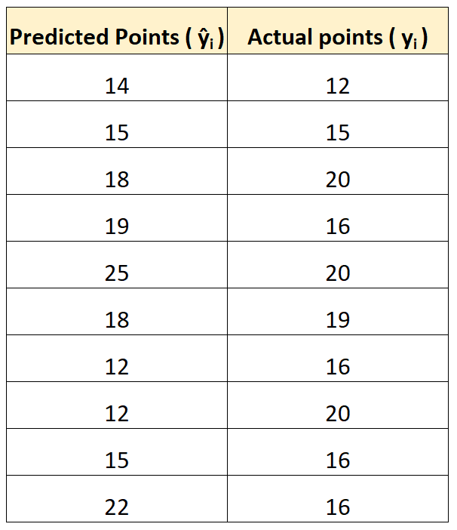
Example 1: Calculating Prediction Error in Linear Regression
Suppose we use a regression model to predict the number of points that 10 players will score in a basketball game.
The following table shows the predicted points from the model vs. the actual points the players scored:
The root mean squared error is 4. This tells us that the average deviation between the predicted points scored and the actual points scored is 4.

Slide 15
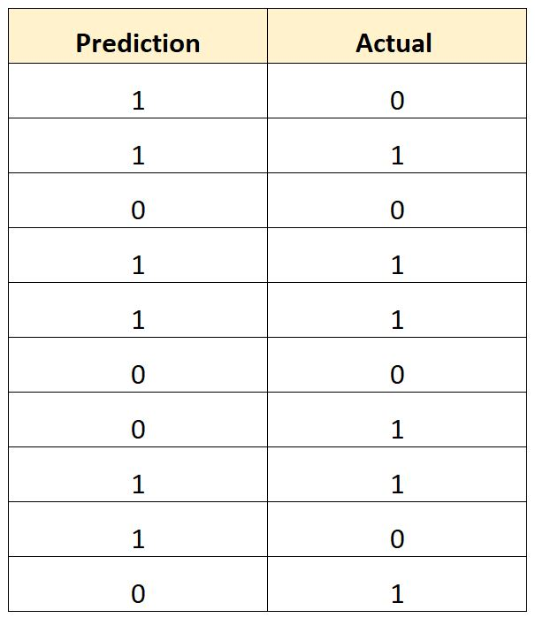
Example 2: Calculating Prediction Error in Logistic Regression
Suppose we use a logistic regression model to predict whether or not 10 college basketball players will get drafted into the NBA.
The following table shows the predicted outcome for each player vs. the actual outcome (1 = Drafted, 0 = Not Drafted):
We would calculate the total misclassification rate as:
Total misclassification rate = (# incorrect predictions / # total predictions)
Total misclassification rate = 4/10
Total misclassification rate = 40%
The total misclassification rate is 40%.
This value is quite high, which indicates that the model doesn’t do a very good job of predicting whether or not a player will get drafted.

Slide 16
Misclassification Rate
In machine learning, misclassification rate is a metric that tells us the percentage of observations that were incorrectly predicted by some classification model.
It is calculated as:
Misclassification Rate = # incorrect predictions / # total predictions
The value for misclassification rate can range from 0 to 1 where:
0 represents a model that had zero incorrect predictions.
1 represents a model that had completely incorrect predictions.
The lower the value for the misclassification rate, the better a classification model is able to predict the outcomes of the response variable.

Slide 17
Pros & Cons of Misclassification Rate
Pros:
It’s easy to interpret. A misclassification rate of 10% means a model made an incorrect prediction for 10% of the total observations.
It’s easy to calculate. A misclassification rate is calculated as the number of total incorrect predictions divided by the total number of predictions.
Con:
It doesn’t take into account how the data is distributed. For example, suppose 90% of all players do not get drafted into the NBA. If we have a model that simply predicts every player to not get drafted, the model would have a misclassification rate of just 10%. This seems low, but, but the model is actually unable to correctly predict any player who gets drafted.

Slide 18
Bias-Variance
To evaluate the performance of a model on a dataset, we need to measure how well the model predictions match the observed data.
For regression models, the most commonly used metric is the mean squared error (MSE), which is calculated as:
MSE = (1/n)*Σ(yi – f(xi))2
where:
n: Total number of observations
yi: The response value of the ith observation
f(xi): The predicted response value of the ith observation
The closer the model predictions are to the observations, the smaller the MSE will be.

Slide 19
Bias-Variance
However, we only care about test MSE – the MSE when our model is applied to unseen data. This is because we only care about how the model will perform on unseen data, not existing data.
test MSE can always be decomposed into two parts:
(1) The variance: Refers to the amount by which our function f would change if we estimated it using a different training set.
(2) The bias: Refers to the error that is introduced by approximating a real-life problem, which may be extremely complicated, by a much simpler model.
Test MSE = Variance + Bias² + Irreducible error

Slide 20
Bias-Variance
However, we only care about test MSE – the MSE when our model is applied to unseen data. This is because we only care about how the model will perform on unseen data, not existing data.
test MSE can always be decomposed into two parts:
(1) The variance: Refers to the amount by which our function f would change if we estimated it using a different training set.
(2) The bias: Refers to the error that is introduced by approximating a real-life problem, which may be extremely complicated, by a much simpler model.
Test MSE = Variance + Bias² + Irreducible error
The irreducible error, is the error that cannot be reduced by any model simply because there always exists some noise in the relationship between the set of explanatory variables and the response variable.

Slide 21
Models that have high bias tend to have low variance. For example, linear regression models tend to have high bias (assumes a simple linear relationship between explanatory variables and response variable) and low variance (model estimates won’t change much from one sample to the next).
However, models that have low bias tend to have high variance. For example, complex non-linear models tend to have low bias (does not assume a certain relationship between explanatory variables and response variable) with high variance (model estimates can change a lot from one training sample to the next).

Slide 22
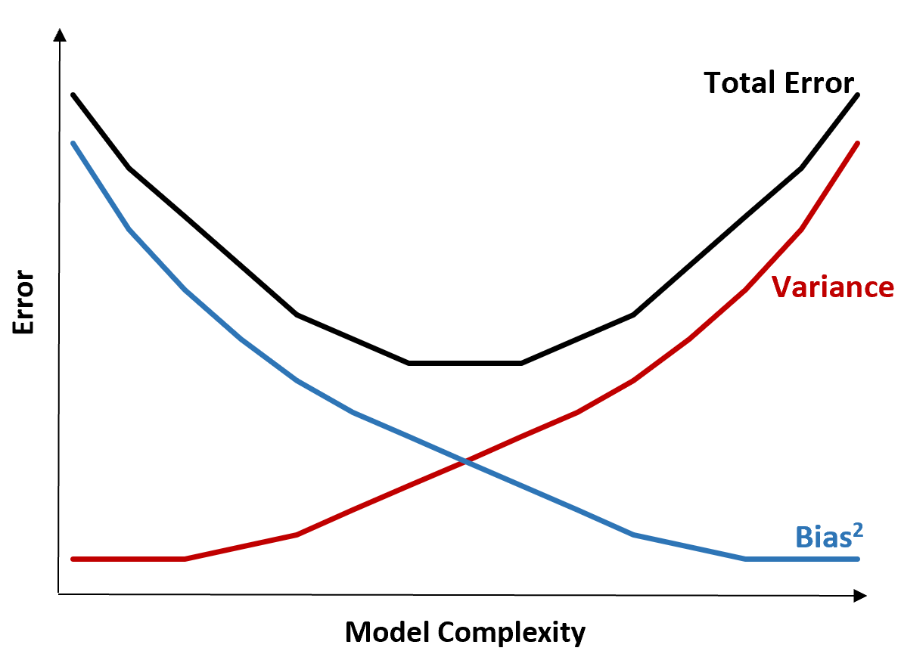
The Bias-Variance Tradeoff
The bias-variance tradeoff refers to the tradeoff that takes place when we choose to lower bias which typically increases variance, or lower variance which typically increases bias.
The following chart offers a way to visualize this tradeoff:

Slide 23
The Bias-Variance Tradeoff
The total error decreases as the complexity of a model increases but only up to a certain point. Past a certain point, variance begins to increase and total error also begins to increase.
In practice, we only care about minimizing the total error of a model, not necessarily minimizing the variance or bias. It turns out that the way to minimize the total error is to strike the right balance between variance and bias.
In other words, we want a model that is complex enough to capture the true relationship between the explanatory variables and the response variable, but not overly complex such that it finds patterns that don’t really exist.

Slide 24
The Bias-Variance Tradeoff
When a model is too complex, it overfits the data. This happens because it works too hard to find patterns in the training data that are just caused by random chance. This type of model is likely to perform poorly on unseen data.
But when a model is too simple, it underfits the data. This happens because it assumes the true relationship between the explanatory variables and the response variable is more simple than it actually is.
The way to pick optimal models in machine learning is to strike the balance between bias and variance such that we can minimize the test error of the model on future unseen data.

Slide 25
What is Overfitting in Machine Learning?
For example, suppose we want to build a regression model that uses the predictor variable hours spent studying to predict the response variable ACT score for students in high school.
To build this model, we’ll collect data about hours spent studying and the corresponding ACT Score for hundreds of students in a certain school district.
Then we’ll use this data to train a model that can make predictions about the score a given student will receive based on their total hours studied.
To assess how useful the model is, we can measure how well the model predictions match the observed data. One of the most commonly used metrics for doing so is the mean squared error (MSE)

Slide 26
What is Overfitting in Machine Learning?
The closer the model predictions are to the observations, the smaller the MSE will be.
However, one of the biggest mistakes made in machine learning is optimizing models to reduce training MSE – i.e. how closely the model predictions match up with the data that we used to train the model.
When a model focuses too much on reducing training MSE, it often works too hard to find patterns in the training data that are just caused by random chance. Then when the model is applied to unseen data, it performs poorly.
This phenomenon is known as overfitting. It occurs when we “fit” a model too closely to the training data and we thus end up building a model that isn’t useful for making predictions about new data.

Slide 27
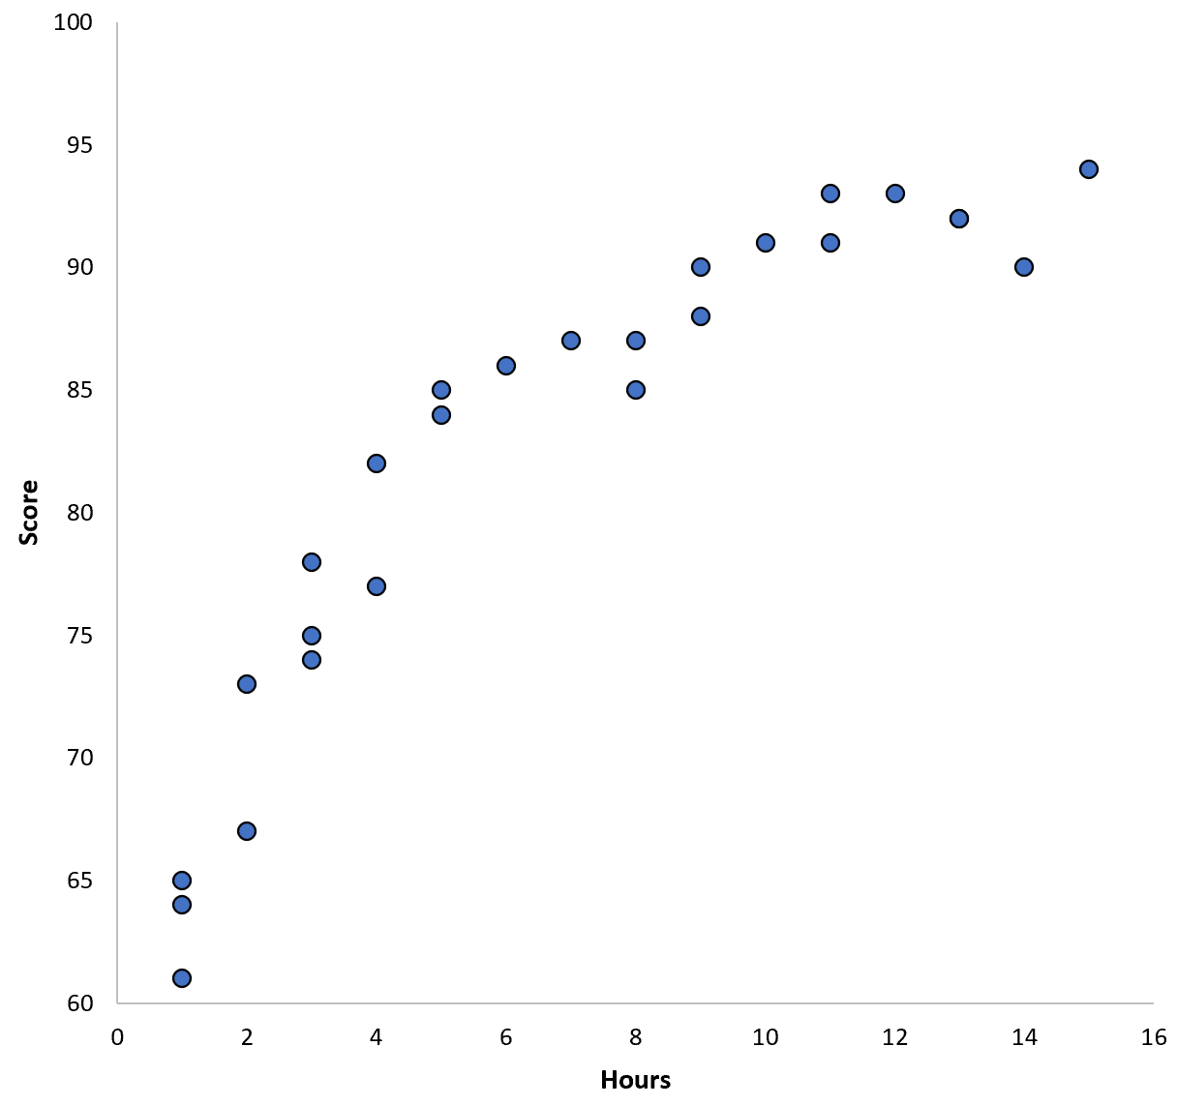
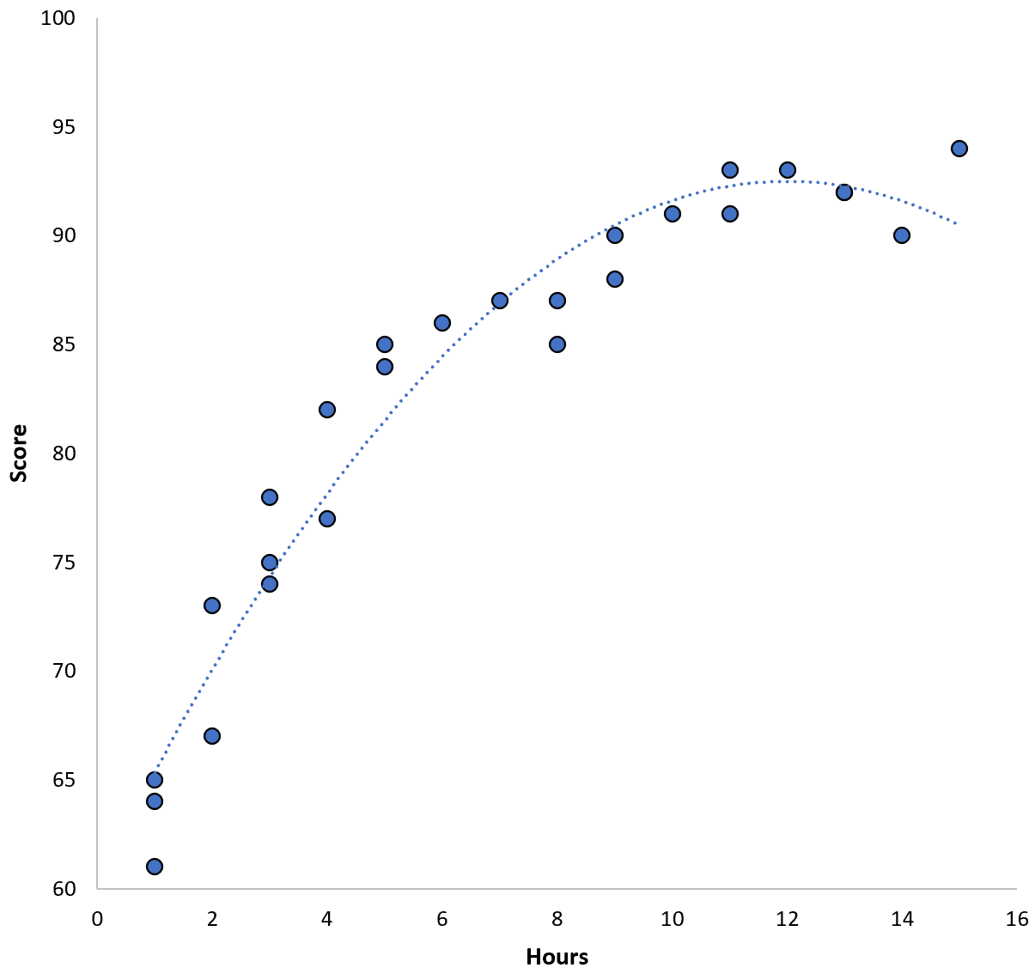

Example of Overfitting
To understand overfitting, let’s return to the example of creating a regression model that uses hours spent studying to predict ACT score.
Suppose we gather data for 100 students in a certain school district and create a quick scatterplot to visualize the relationship between the two variables:

